Slide 1

PHP Laravel Basics
Within 3 Hours

Slide 2
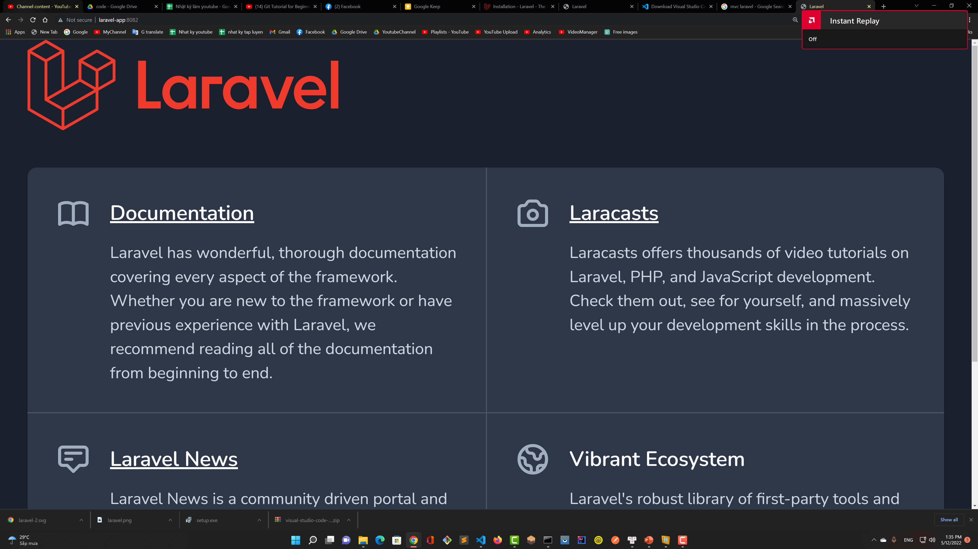

MVC – Model View Controller
Controller
Send request from client
Routing
Model
View
Database

Slide 3
Lập trình PHP
Laravel 9
Cảm ơn các bạn đã quan tâm

Slide 4
PHP Programming
Laravel 9
Thanks for watching

Slide 5

Visual Studio Code
- Easy to use, work both MacOS/Windows
- Many userful extensions
- Build-in git, lightweight

Slide 6
VSCode Extensions
Laravel Artisan,
Laravel Extra Intellisense
Laravel Blade Snippets
Live Sass Compiler
Laravel Blade Spacer
Beautify css/sass/scss/less
Laravel goto view
PHP IntelliSense
laravel snippets
Getter and Setter Generator

Slide 7
VSCode Extensions
Laravel Artisan,
Getter and Setter Generator
Bracket Pair Colorization Toggler
Vscode-icons
JavaScript (ES6) code snippets

Slide 8
What is .env File ?
It store environment variables, use globally in your App
Store in Laravel App’s root folder
File name is blank: .env

Slide 9
What is composer.json ?
It is a file where stores and manages dependencies / libraries

Slide 10
Where can I find dependencies ?
You can find Laravel dependencies at: packagist.org

Slide 11
Basic routing in Laravel
Routing configurations are saved on routes/web.php
Examples:
http://server-name:port/
http://server-name:port/products
http://server-name:port/users
. . .

Slide 12
What do you need ?
Visual Studio Code

